Slide 1
Lecture 4: Introduction to Regression

Slide 2
ANNOUNCEMENTS
Advanced Sections (A-Sections):
Wednesday (start 9/18) @ 4:30pm (Sever 113)
Late registrations:
We will not approve more registrations after tonight 10:00pm. Note, if you are registering late, your grade for HW0 will be 0 and there will be no extension to HW1.

Slide 3
ANNOUNCEMENTS
Homework 0 isn’t graded for accuracy; however some submissions are strange:
.json file instead of the notebook
totally empty solutions – no attempt whatsoever
.rar files
Solution to a different homework that is not CS109A HW0
Solution to last year’s homework

Slide 4
ACADEMY HONESTY
Ethical behavior is an important trait of a Data Scientist, from ethically handling data to attribution of code and work of others. Thus, in CS109 we give a strong emphasis to Academic Honesty .
As a student your best guidelines are to be reasonable and fair. We encourage teamwork problem sets, but you should not split the homework and you should work on all the problems together.
Engaging in not acceptable behavior regarding academic honesty will be handled harshly.

Slide 5
ACADEMY HONESTY
Engaging in not acceptable behavior regarding academic honesty will be handled harshly.
Please be responsible and when in doubt ask the CS109 Heads.

Slide 6
ACADEMY HONESTY
ACCEPTABLE:
➔ Discussing materials and engaging in OH.
➔ Helping debug.
➔ Using a few lines of code found online or other forum as long as you cite the origin and attribute authorship of code.
➔ Searching online to expand your knowledge and for debugging, but not for outright solutions to HWs or final project.
➔ Using a tutor, provided the tutor does not do your work for you.

Slide 7
ACADEMY HONESTY
NOT ACCEPTABLE:
➔ Submitting the same or similar work to CS109 that you have submitted previously to this or another course (or will submit to another course).
➔ Submitting work to CS109 that you intend to use outside of the course (e.g., for a job) without prior approval from the CS109 Heads.
➔ Accessing a solution to some problem prior to submitting your own.
➔ Failing to cite the origins of code or techniques that you discover outside of the course’s own lessons and integrate into your own work.

Slide 8
ACADEMY HONESTY
NOT ACCEPTABLE:
➔ Paying or offering to pay an individual for work that you may submit as your own.
➔ Providing or making available solutions to problem sets to individuals who might take this course in the future.
➔ Searching for or soliciting outright solutions to problem sets online or
elsewhere.
➔ Splitting a problem set’s workload with another individual and combining your work.

Slide 9
Background
Roadmap:
Lecture 1
Lecture 2
Lecture 3 and Lab2
This lecture
Next 3 lectures
What is Data Science?
Data: types, formats, issues, etc, and briefly visualization
How to quickly prepare data and scrape the web
How to model data and evaluate model fitness.
Linear regression, confidence intervals, model selection cross validation, regularization

Slide 10
Lecture Outline
Statistical Modeling
k-Nearest Neighbors (kNN)
Model Fitness
How does the model perform predicting?
Comparison of Two Models
How do we choose from two different models?

Slide 11
Predicting a Variable
Let's image a scenario where we'd like to predict one variable using another (or a set of other) variables.
Examples:
Predicting the amount of view a YouTube video will get next week based on video length, the date it was posted, previous number of views, etc.
Predicting which movies a Netflix user will rate highly based on their previous movie ratings, demographic data etc.

Slide 12
Data
The Advertising data set consists of the sales of that product in 200 different markets, along with advertising budgets for the product in each of those markets for three different media: TV, radio, and newspaper. Everything is given in units of $1000.
,
TV | radio | newspaper | sales
230.1 | 37.8 | 69.2 | 22.1
44.5 | 39.3 | 45.1 | 10.4
17.2 | 45.9 | 69.3 | 9.3
151.5 | 41.3 | 58.5 | 18.5
180.8 | 10.8 | 58.4 | 12.9
Some of the figures in this presentation are taken from "An Introduction to Statistical Learning, with applications in R" (Springer, 2013) with permission from the authors: G. James, D. Witten, T. Hastie and R. Tibshirani "
Notes:
Supposed we were asked by a client to provide advice on how to improve sales of a particular product.
Does that footnote belong on this slide?

Slide 13
Response vs. Predictor Variables
There is an asymmetry in many of these problems:
The variable we'd like to predict may be more difficult to measure, is more important than the other(s), or may be directly or indirectly influenced by the values of the other variable(s).
Thus, we'd like to define two categories of variables:
variables whose value we want to predict
variables whose values we use to make our prediction
Notes:
Give an example

Slide 14
Response vs. Predictor Variables
X
predictors
features
covariates
Y
outcome
response variable
dependent variable
TV | radio | newspaper | sales
230.1 | 37.8 | 69.2 | 22.1
44.5 | 39.3 | 45.1 | 10.4
17.2 | 45.9 | 69.3 | 9.3
151.5 | 41.3 | 58.5 | 18.5
180.8 | 10.8 | 58.4 | 12.9
n observations
p predictors

Slide 15
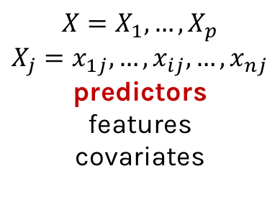
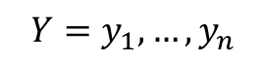
Response vs. Predictor Variables
$$X=X_{1},…,X_{p}$$
$$X_{j}=x_{1j},…,x_{ij},…,x_{nj}$$
predictors
features
covariates
outcome
response variable
dependent variable
$$Y=y_{1},…,y_{n}$$
TV | radio | newspaper | sales
230.1 | 37.8 | 69.2 | 22.1
44.5 | 39.3 | 45.1 | 10.4
17.2 | 45.9 | 69.3 | 9.3
151.5 | 41.3 | 58.5 | 18.5
180.8 | 10.8 | 58.4 | 12.9
n observations
p predictors
Notes:
I changed y_p to y_n. I think this makes the dimensions correct now. (DLS)

Slide 16
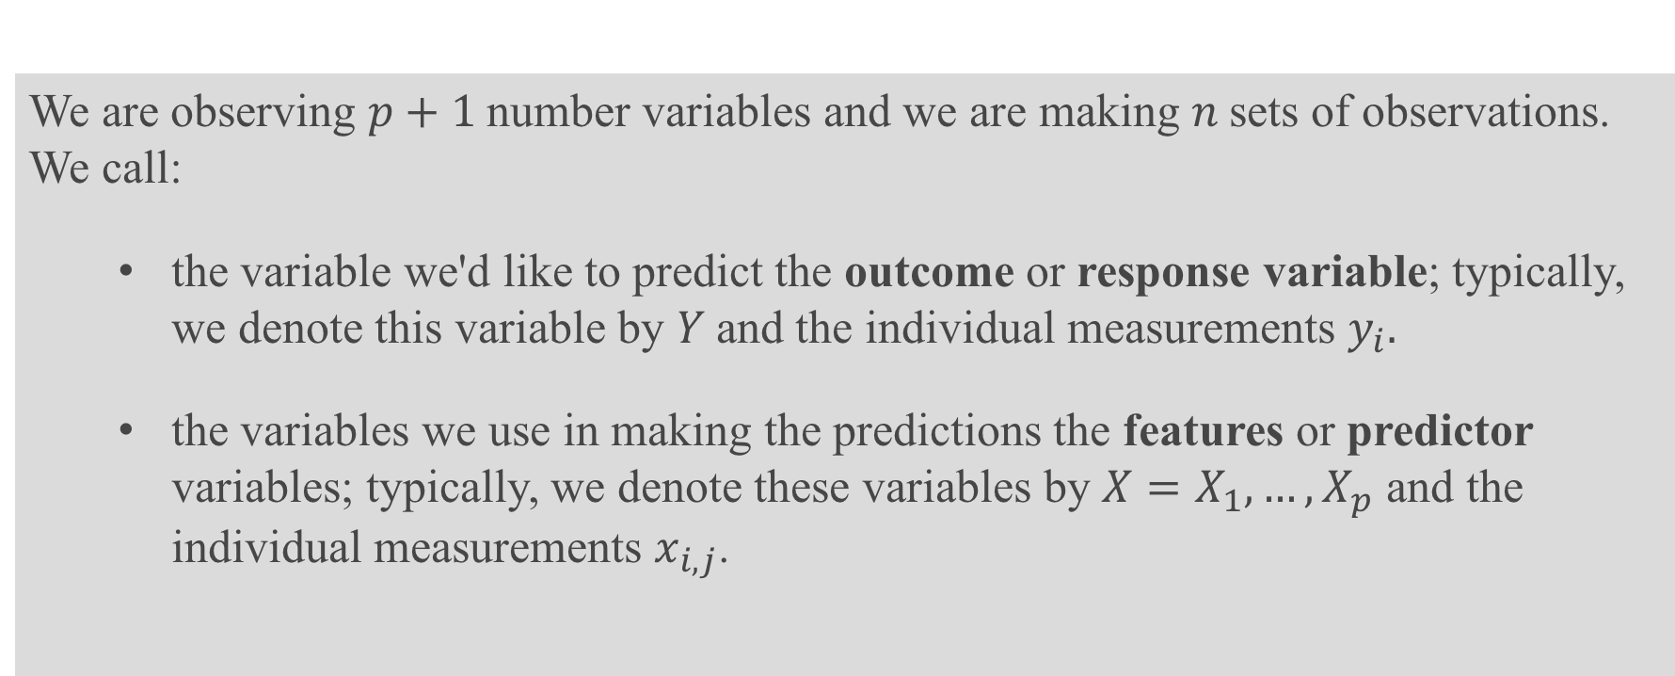
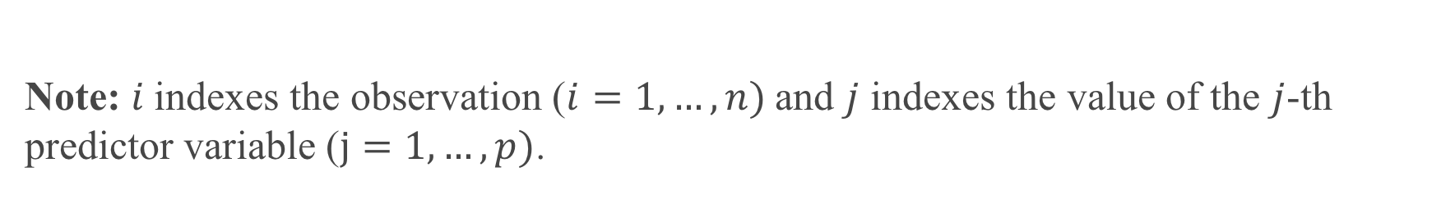
Definition
We are observing $p+1$number variables and we are making $n$sets of observations. We call:
the variable we'd like to predict the outcome or response variable; typically, we denote this variable by $Y$and the individual measurements $y_{i}.$
the variables we use in making the predictions the features or predictor variables; typically, we denote these variables by $X=X_{1},…,X_{p}$ and the individual measurements $x_{i,j}$.
Note: $i$indexes the observation ($i=1,…,n)$and $j$ indexes the value of the $j$-th predictor variable ($j=1,…,p)$.

Slide 17
Statistical Model

Slide 18
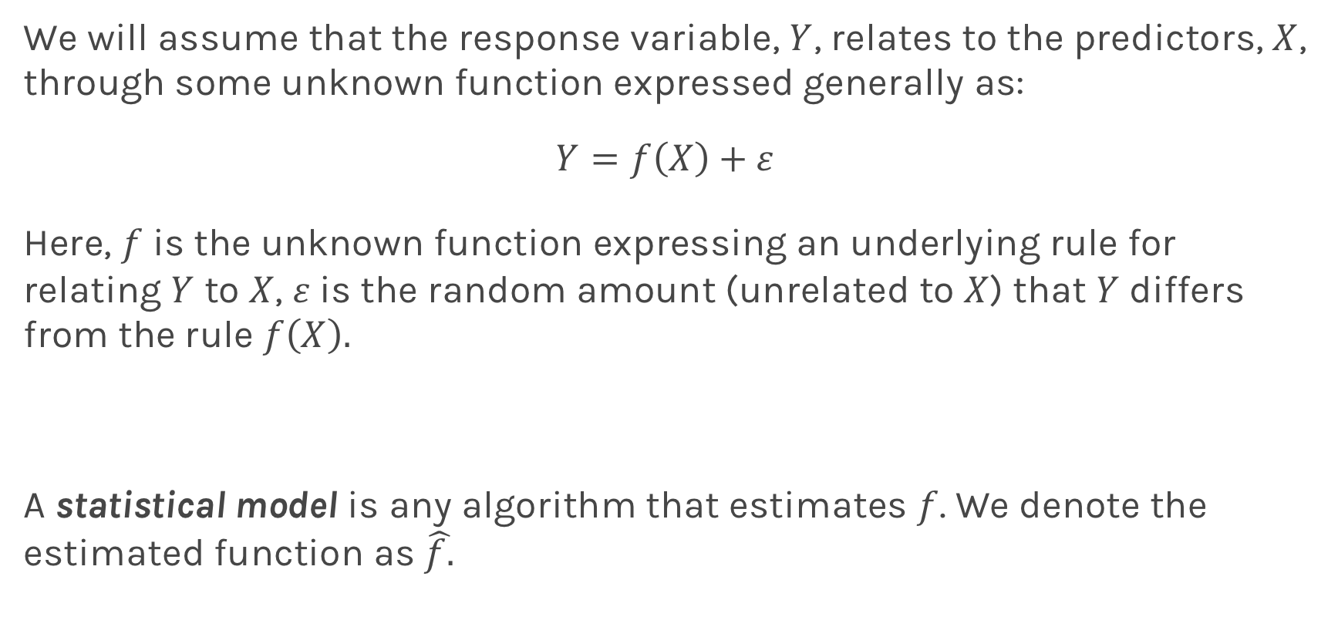
True vs. Statistical Model
We will assume that the response variable, $Y$, relates to the predictors, $X$, through some unknown function expressed generally as:
$$Y=f\left(X\right)+ε$$
Here, $f$ is the unknown function expressing an underlying rule for relating $Y$ to $X$, $ε$is the random amount (unrelated to $X$) that $Y$ differs from the rule $f\left(X\right).$
A statistical model is any algorithm that estimates $f$. We denote the estimated function as $\hat{f.}$
Notes:
Change x and y to uppercase? (DLS)

Slide 19
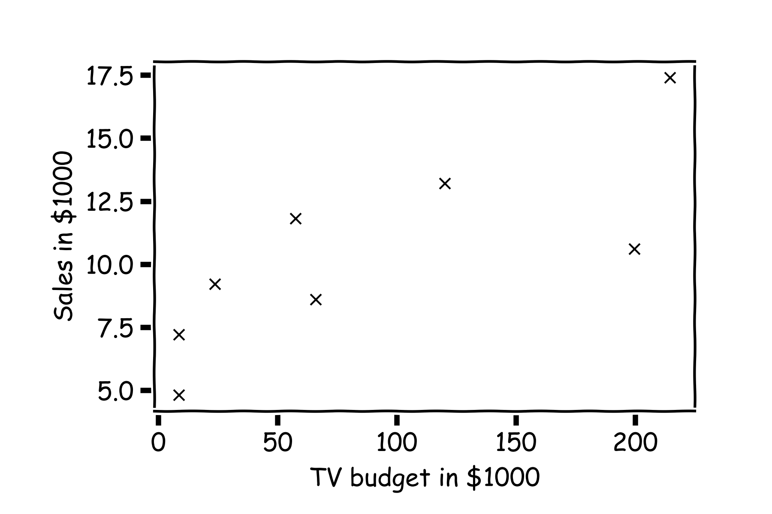
Statistical Model
y
x

Slide 20
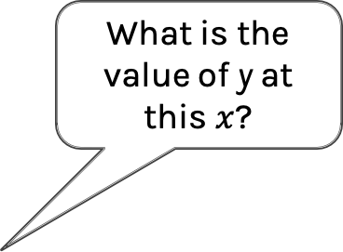
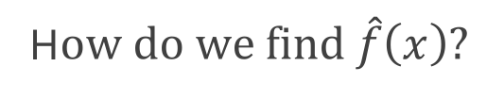
Statistical Model
H$ow do we find \hat{f}\left(x\right)?$
What is the value of y at this $x$?

Slide 21
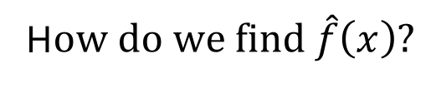
Statistical Model
H$ow do we find \hat{f}\left(x\right)?$
or this one?

Slide 22
Statistical Model
Simple idea is to take the mean of all y’s, $\hat{f}\left(x\right)=\frac{1}{n}\sum_{1}^{n}{y_{i}}$

Slide 23
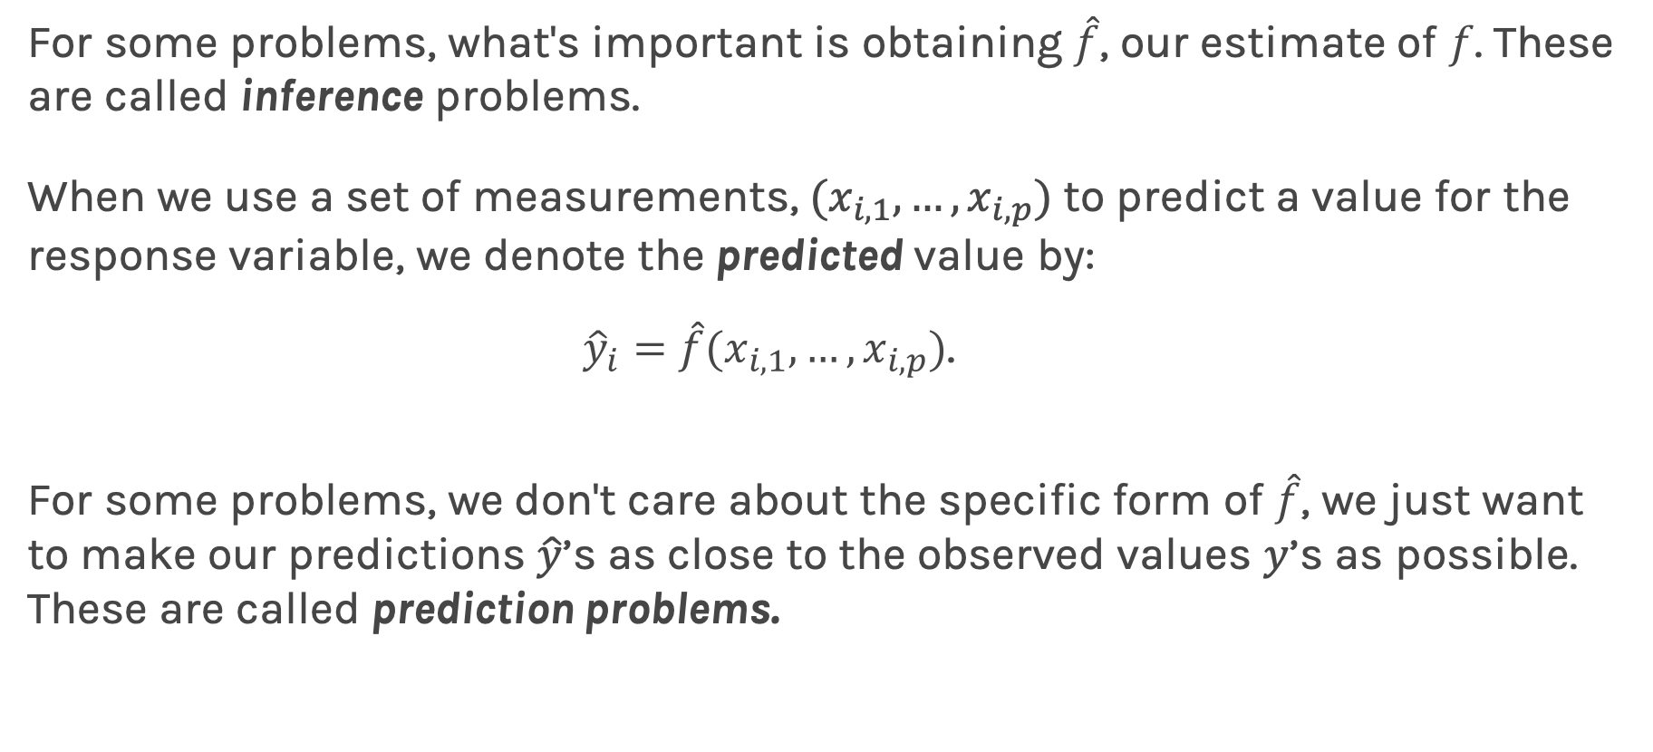
Prediction vs. Estimation
For some problems, what's important is obtaining $\hat{f}$, our estimate of $f$. These are called inference problems.
When we use a set of measurements, $(x_{i,1}, …,x_{i,p})$ to predict a value for the response variable, we denote the predicted value by:
${\hat{y}}_{i}=$ $\hat{f}(x_{i,1}, …,x_{i,p})$.
For some problems, we don't care about the specific form of $\hat{f}$, we just want to make our predictions $\hat{y}$’s as close to the observed values $y$’s as possible. These are called prediction problems.

Slide 24
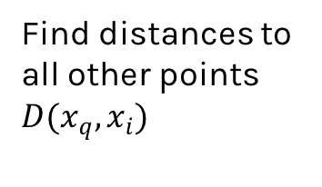
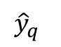
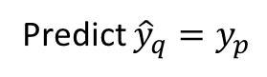
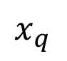
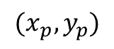
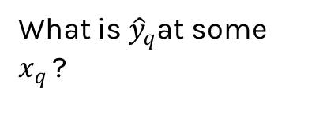
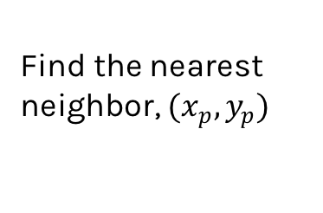
Simple Prediction Model
What is ${\hat{y}}_{q}$at some $x_{q }$?
Find distances to all other points $D(x_{q},x_{i})$
$${(x}_{p},y_{p})$$
$${\hat{y}}_{q}$$
Find the nearest neighbor, ${(x}_{p},y_{p})$
Predict ${\hat{y}}_{q}=y_{p}$
$$x_{q}$$
Notes:
Is it clear that x_q is really x_i,q? (DLS)

Slide 25
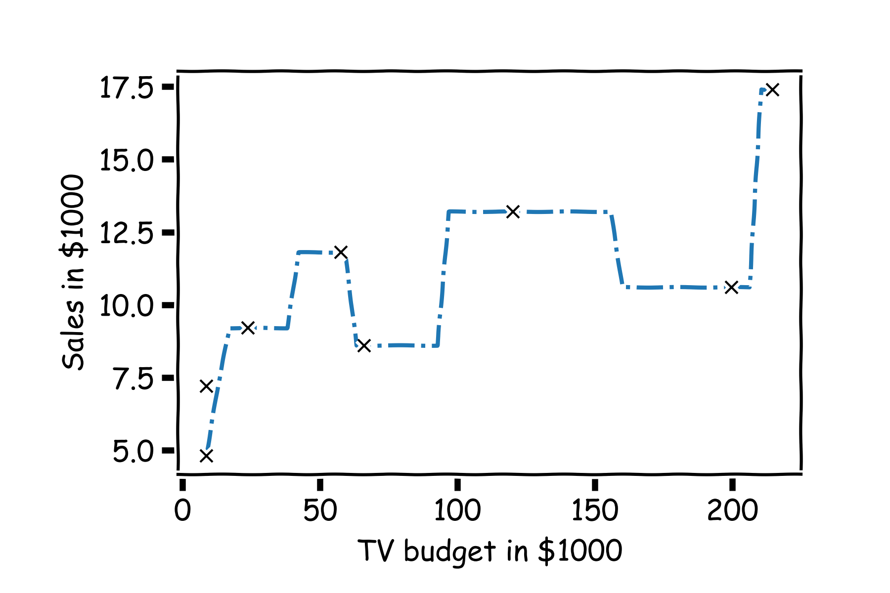
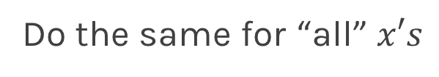
Simple Prediction Model
Do the same for “all” $x′s$

Slide 26
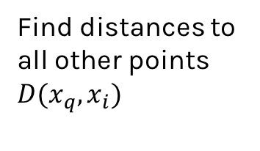
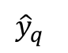
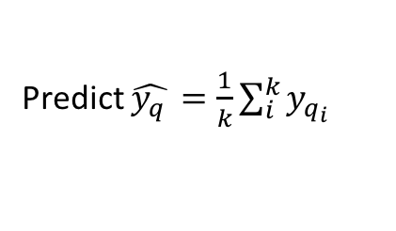
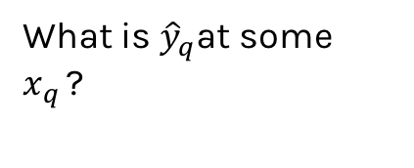
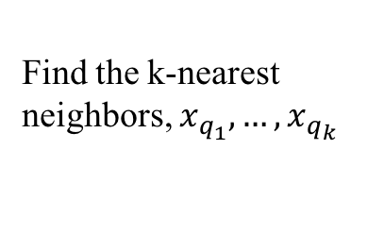
Extend the Prediction Model
What is ${\hat{y}}_{q}$at some $x_{q }$?
Find distances to all other points $D(x_{q},x_{i})$
$${\hat{y}}_{q}$$
Find the k-nearest neighbors, $x_{q_{1}},…,x_{q_{k}}$
Predict $\hat{y_{q }}=\frac{1}{k}\sum_{i}^{k}{y_{q_{i}}}$
$$x_{q}$$
Notes:
Change indeces and show k-nearest

Slide 27
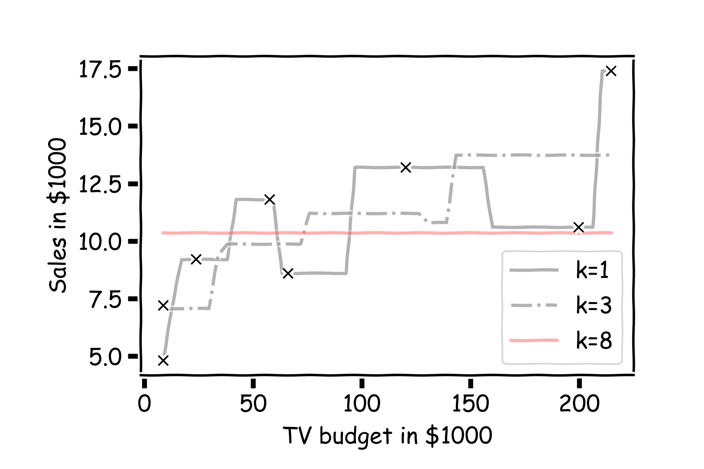
Simple Prediction Models
Notes:
Change indeces and show k-nearest

Slide 28

Simple Prediction Models
We can try different k-models on more data
Notes:
Change indeces and show k-nearest

Slide 29
k-Nearest Neighbors
The k-Nearest Neighbor (kNN) model is an intuitive way to predict a quantitative response variable:
to predict a response for a set of observed predictor values, we use the responses of other observations most similar to it
Note: this strategy can also be applied in classification to predict a categorical variable. We will encounter kNN again later in the course in the context of classification.
Notes:
Change indeces and show k-nearest

Slide 30
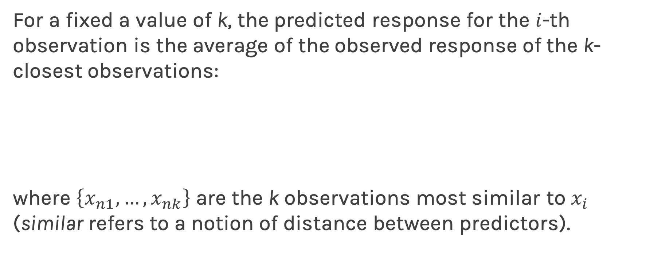
k-Nearest Neighbors - kNN
For a fixed a value of k, the predicted response for the $i$-th observation is the average of the observed response of the k-closest observations:
where $\left\{x_{n1},…,x_{nk}\right\}$ are the k observations most similar to $x_{i}$ (similar refers to a notion of distance between predictors).
Notes:
Notice y_hat instead of f_hat
I think the index on y_hat is wrong but I can’t change it b/c it’s an image. (DLS)

Slide 31
ED quiz: Lecture 4 | part 1
Notes:
Change indeces and show k-nearest

Slide 32
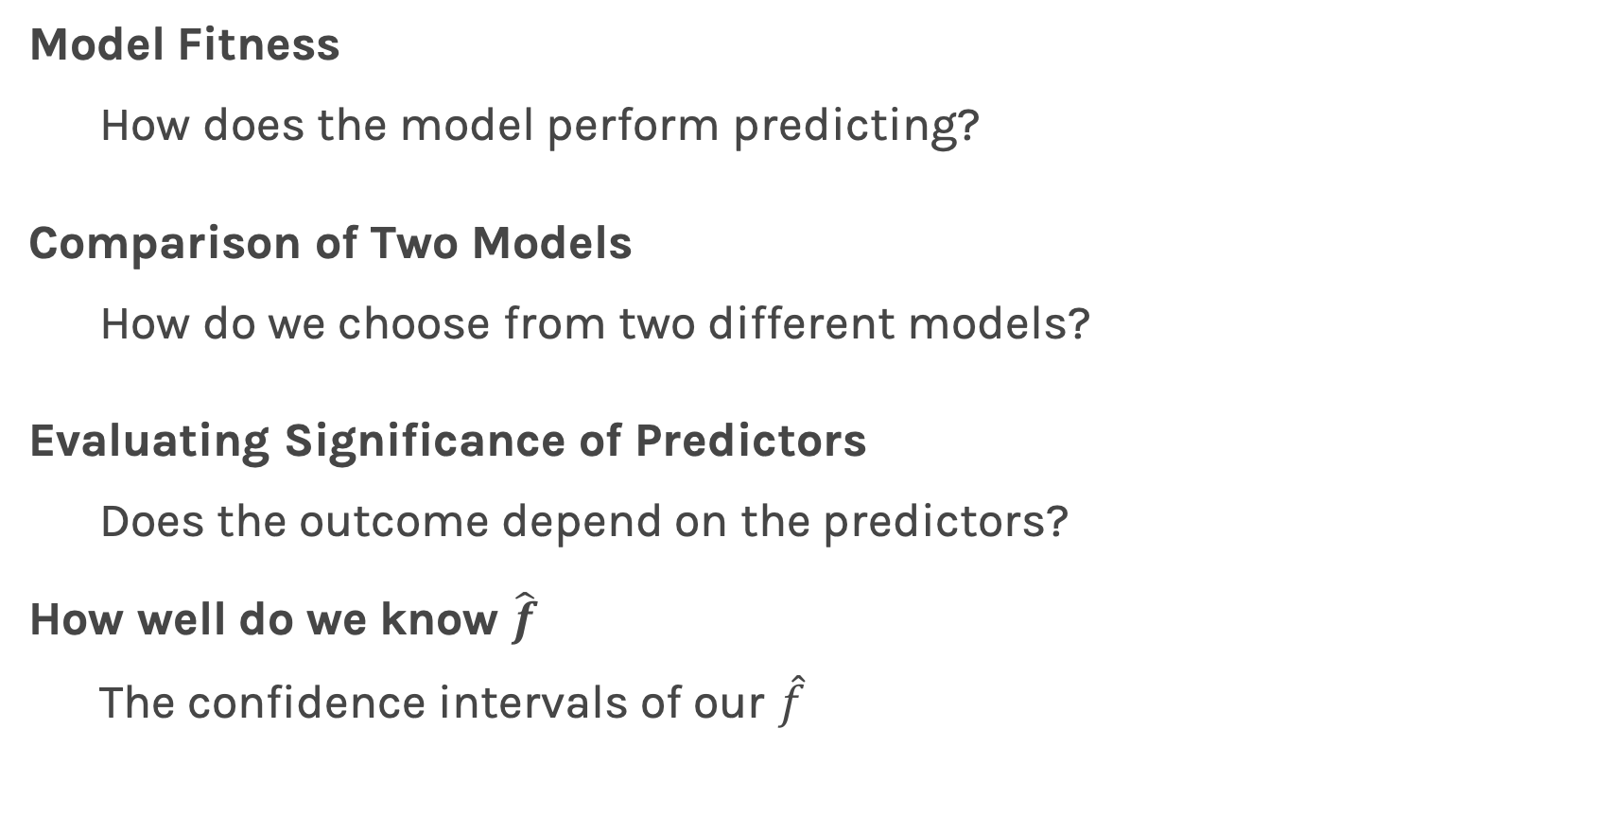
Things to Consider
Model Fitness
How does the model perform predicting?
Comparison of Two Models
How do we choose from two different models?
Evaluating Significance of Predictors
Does the outcome depend on the predictors?
How well do we know $\hat{f}$
The confidence intervals of our $\hat{f}$

Slide 33
Error Evaluation

Slide 34
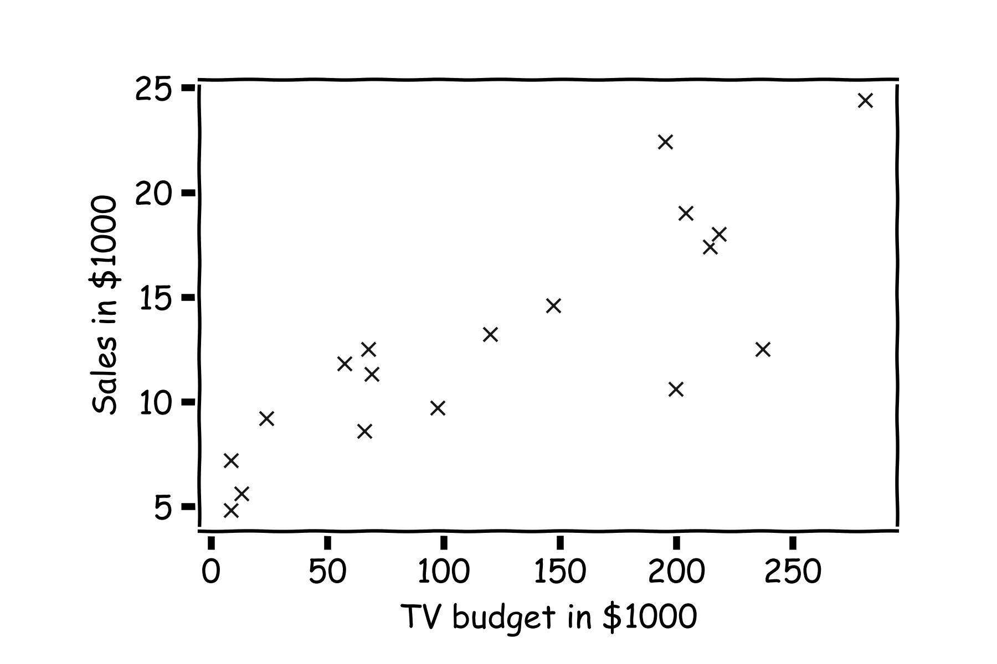
Error Evaluation
Start with some data.
Notes:
Change indeces and show k-nearest

Slide 35
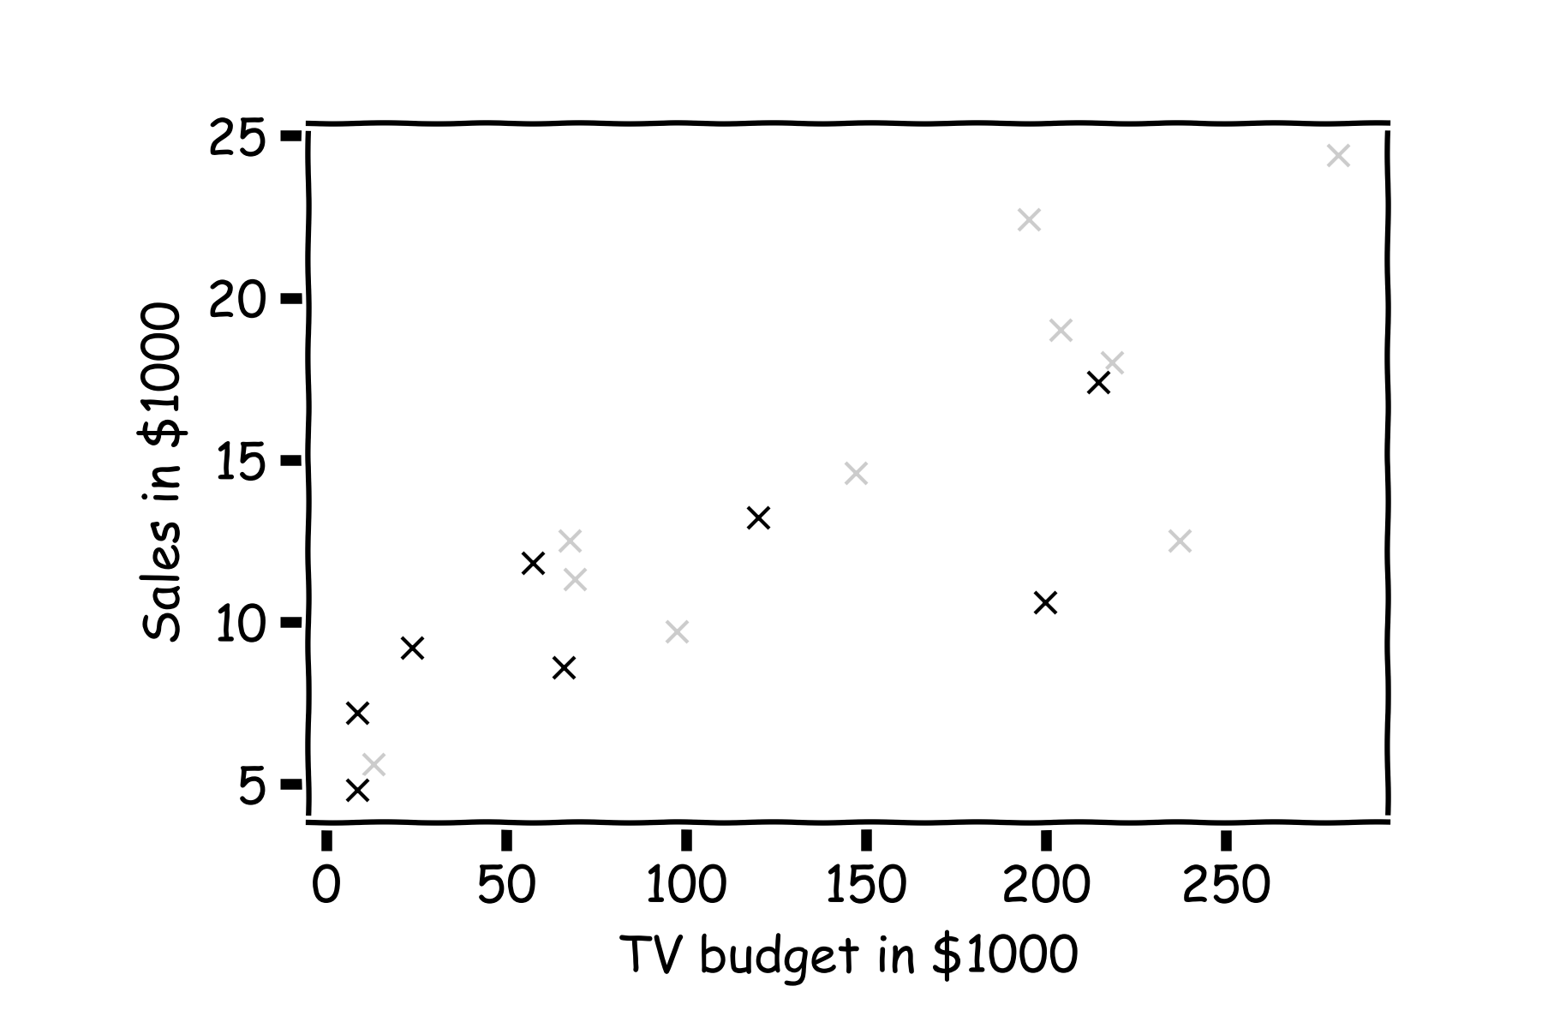
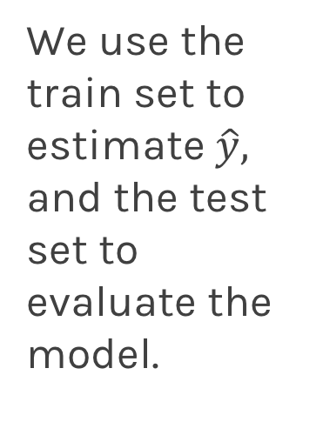
Error Evaluation
Hide some of the data from the model. This is called train-test split.
We use the train set to estimate $\hat{y},$ and the test set to evaluate the model.

Slide 36
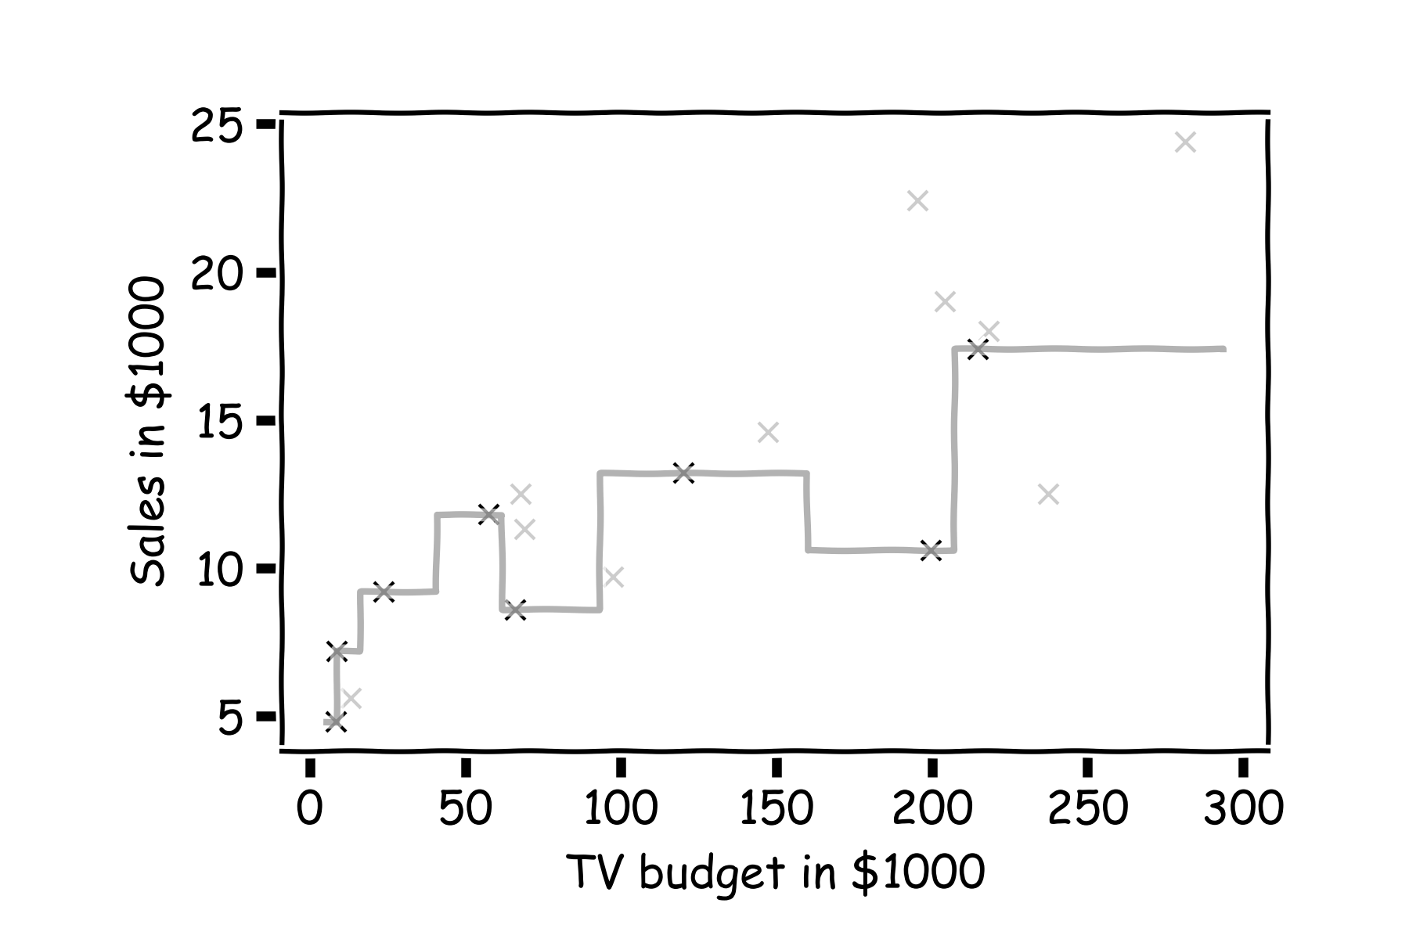
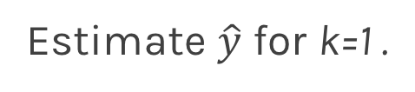
Error Evaluation
Estimate $\hat{y}$ for k=1 .
Notes:
Change indeces and show k-nearest

Slide 37
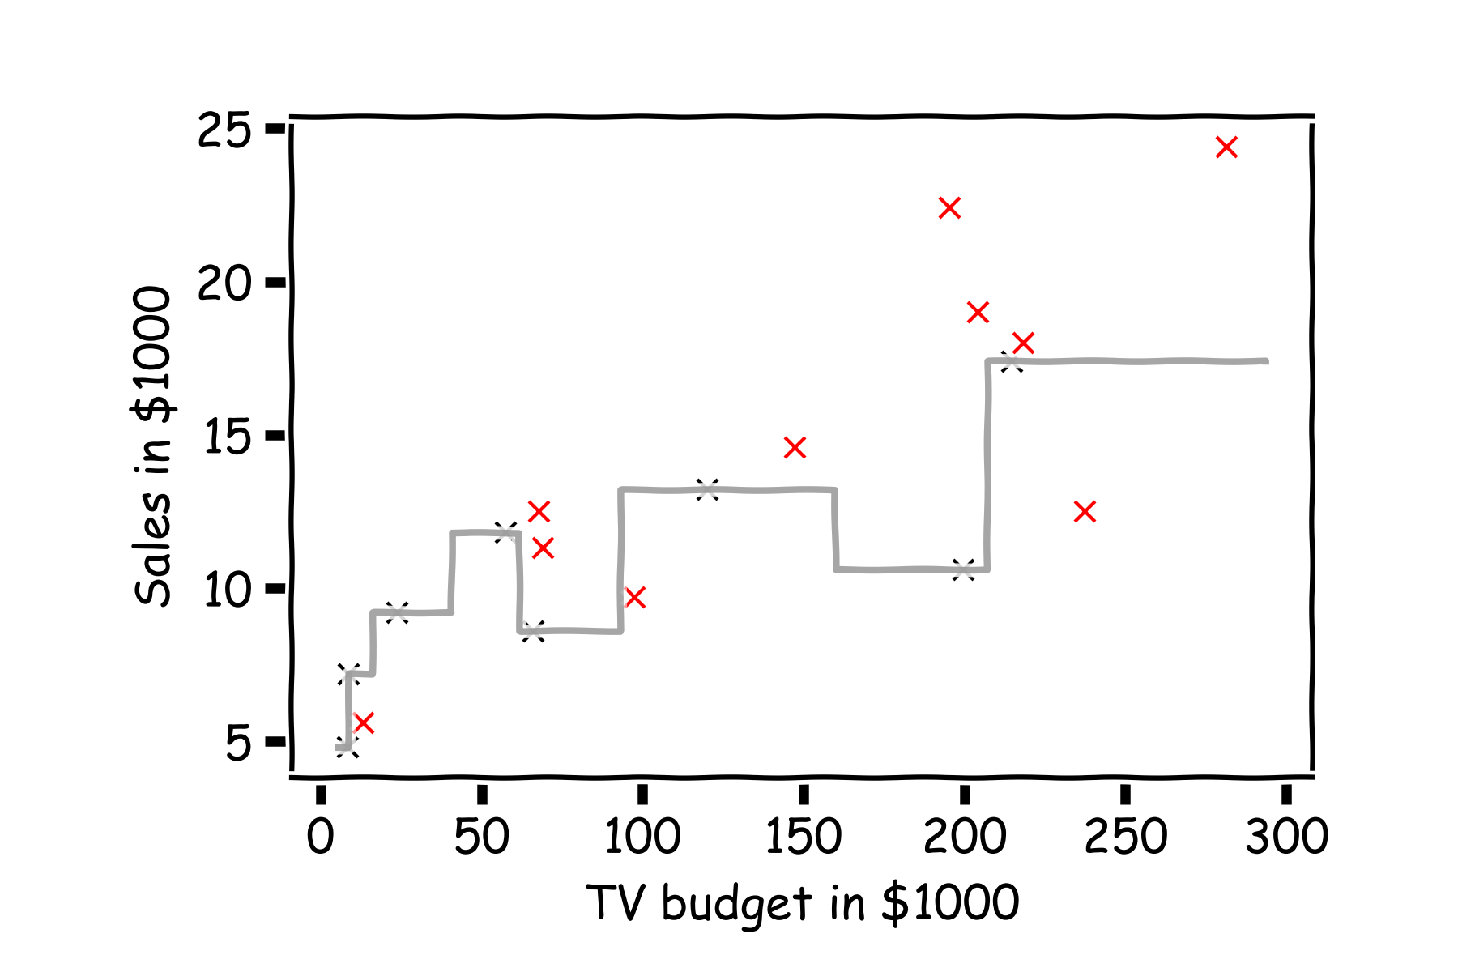
Error Evaluation
Now, we look at the data we have not used, the test data (red crosses).
Notes:
Change indeces and show k-nearest

Slide 38
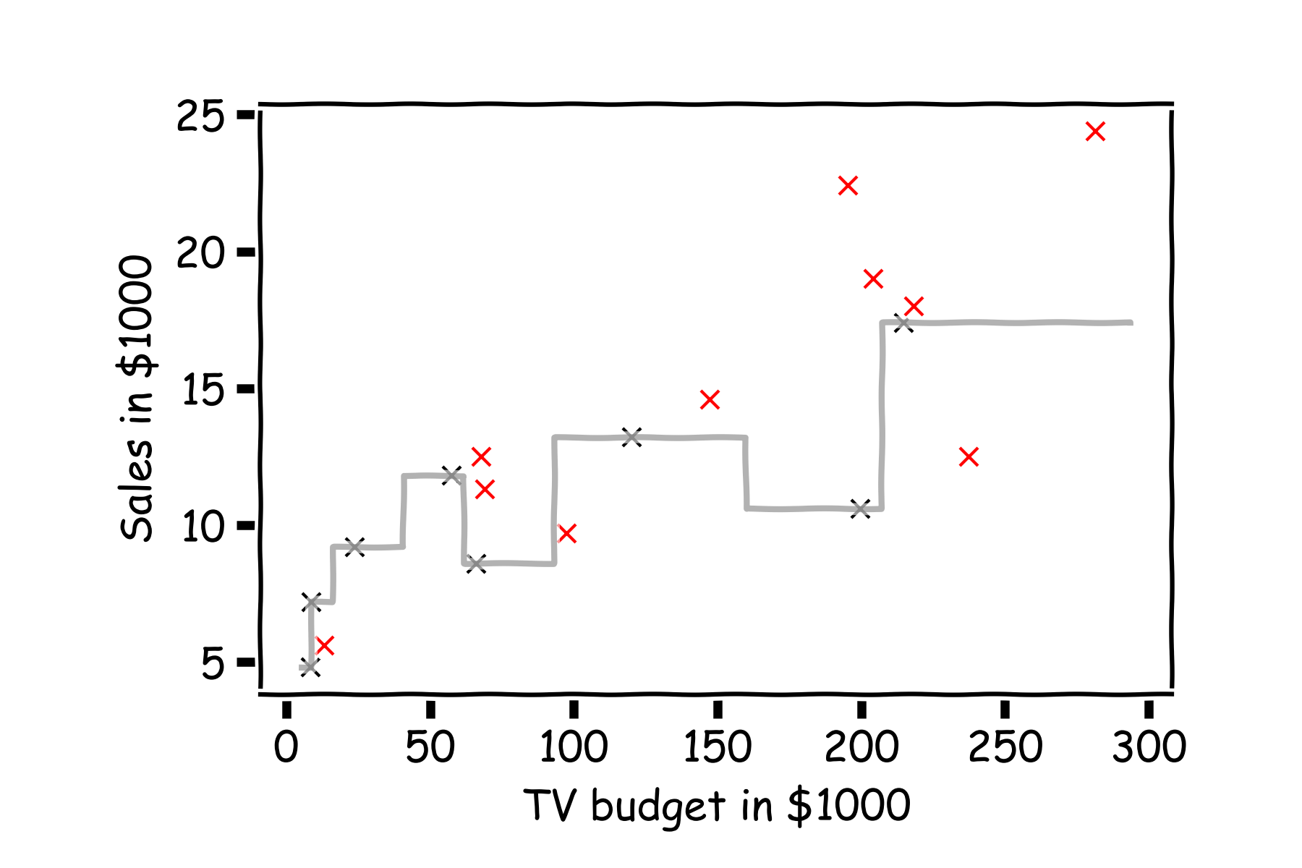
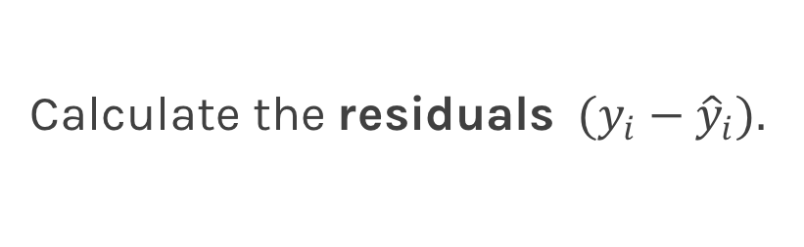
Error Evaluation
Calculate the ${\text{residuals} (y}_{i}−{\hat{y}}_{i}).$
Notes:
Change indeces and show k-nearest

Slide 39
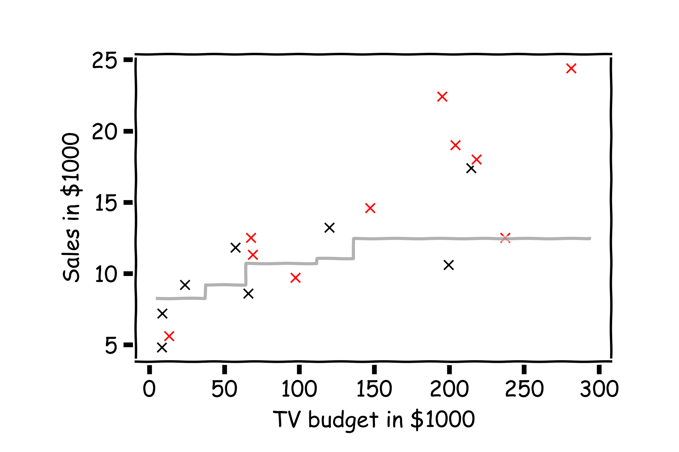
Error Evaluation
Do the same for k=3.
Notes:
Change indeces and show k-nearest

Slide 40
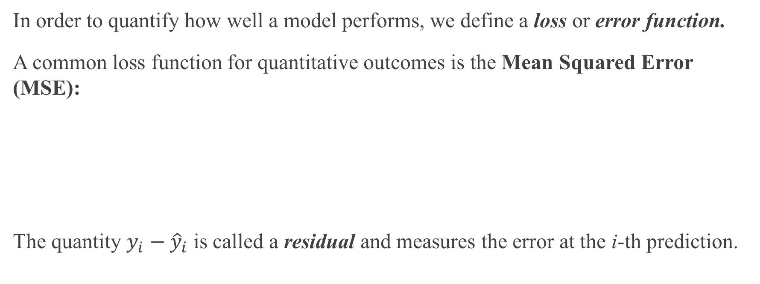
Error Evaluation
In order to quantify how well a model performs, we define a loss or error function.
A common loss function for quantitative outcomes is the Mean Squared Error (MSE):
The quantity $y_{i}−{\hat{y}}_{i}$ is called a residual and measures the error at the i-th prediction.
Notes:
Change indeces and show k-nearest

Slide 41
Error Evaluation
Caution: The MSE is by no means the only valid (or the best) loss function!
Question: What would be an intuitive loss function for predicting categorical outcomes?
Note: The square Root of the Mean of the Squared Errors (RMSE) is also commonly used.
Notes:
Change indeces and show k-nearest
Do you want to mention that RMSE isn’t always great b/c it’s not smooth? This would give them an idea on the things to consider when choosing loss functions. (DLS)

Slide 42
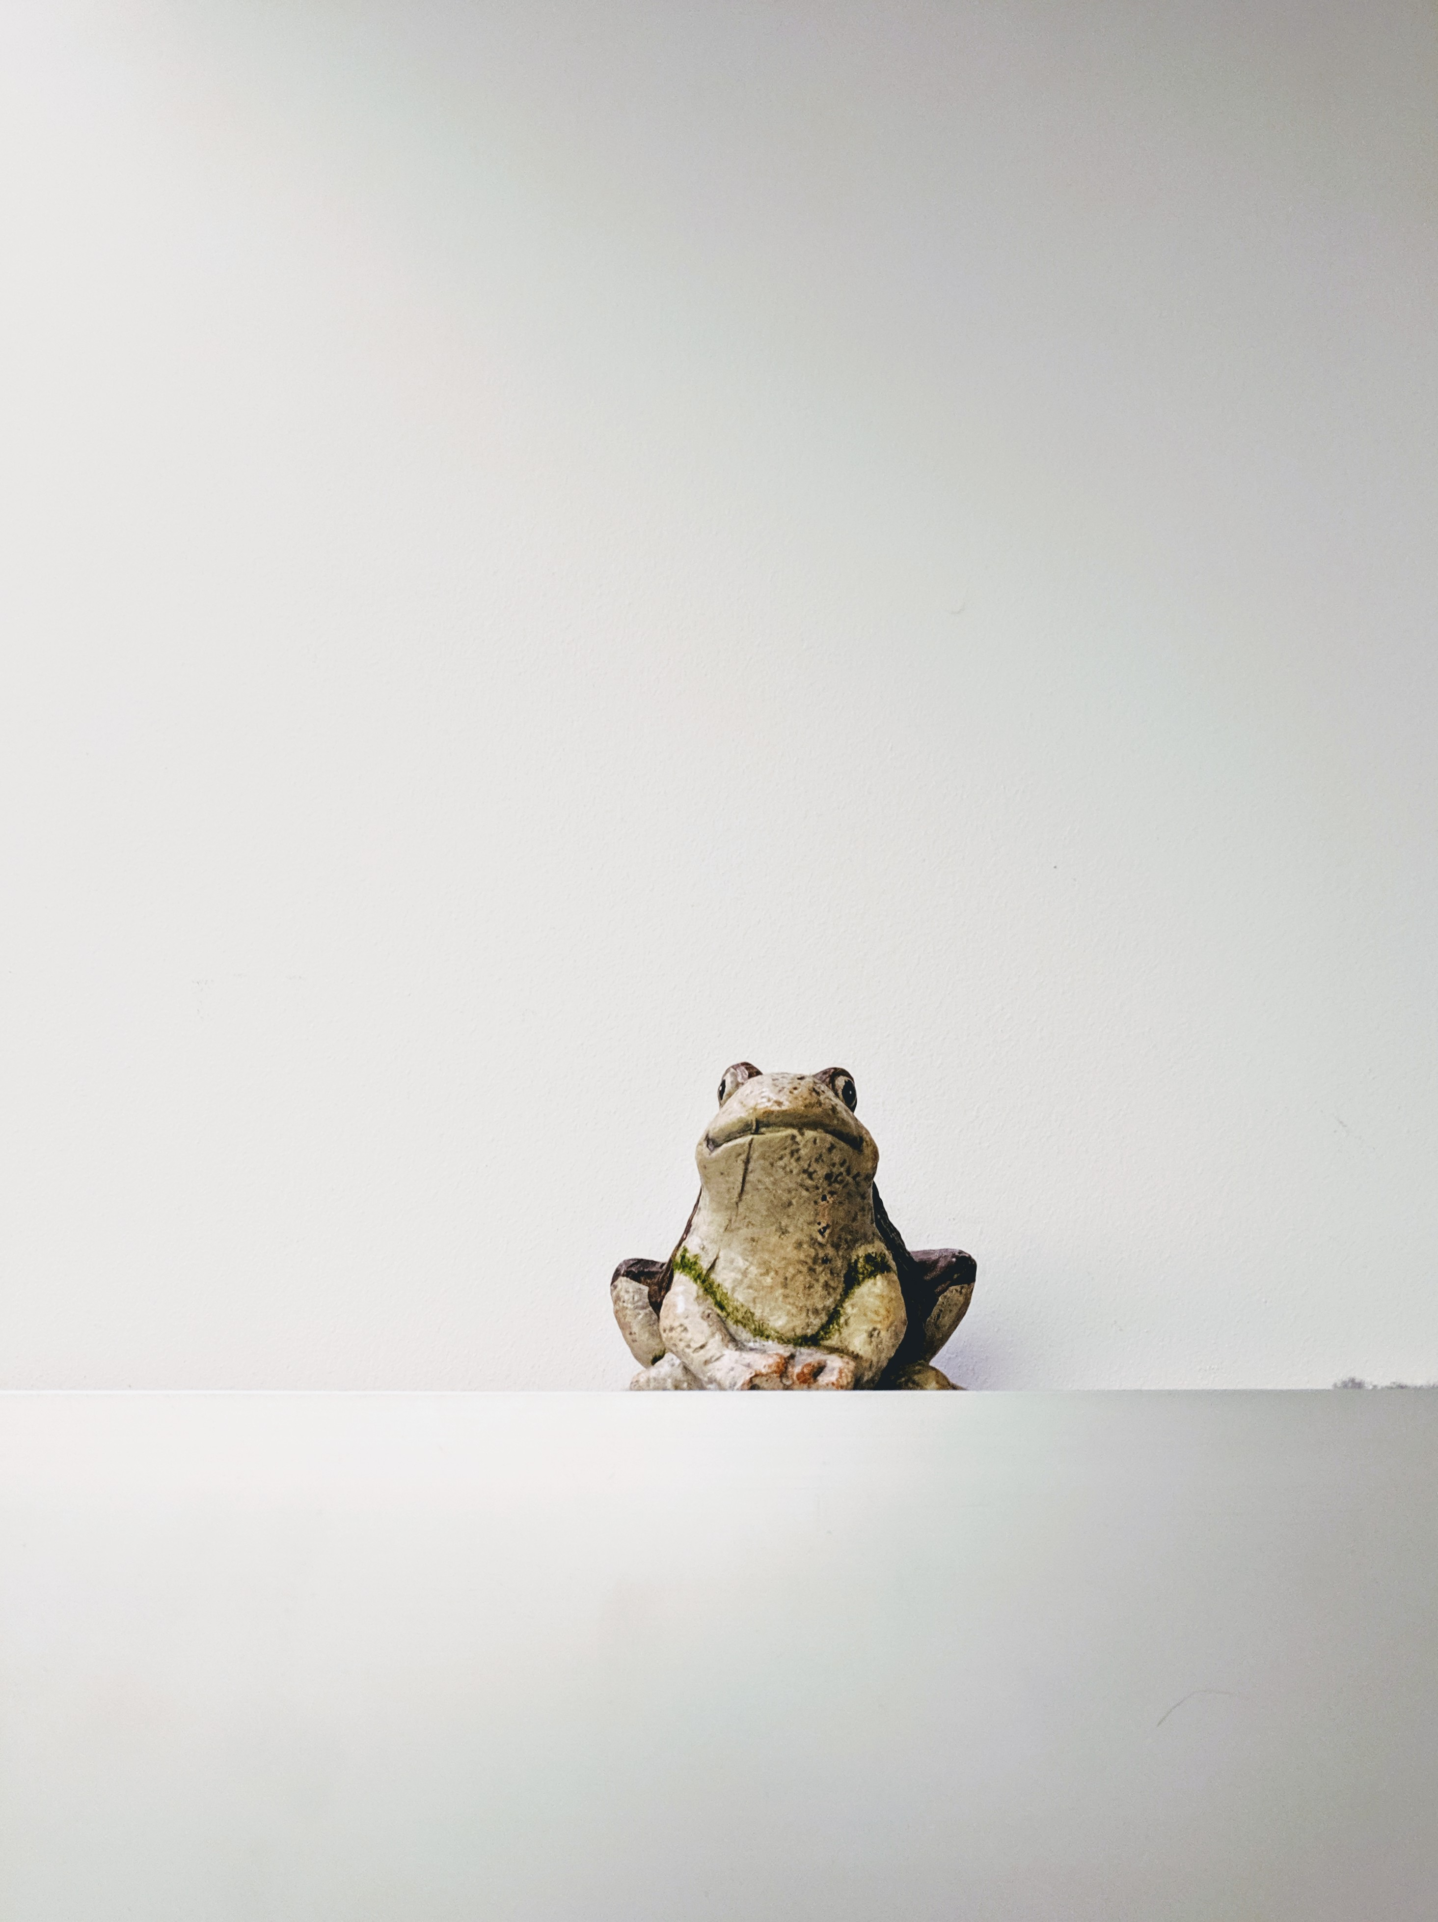
Find Me?

Slide 43
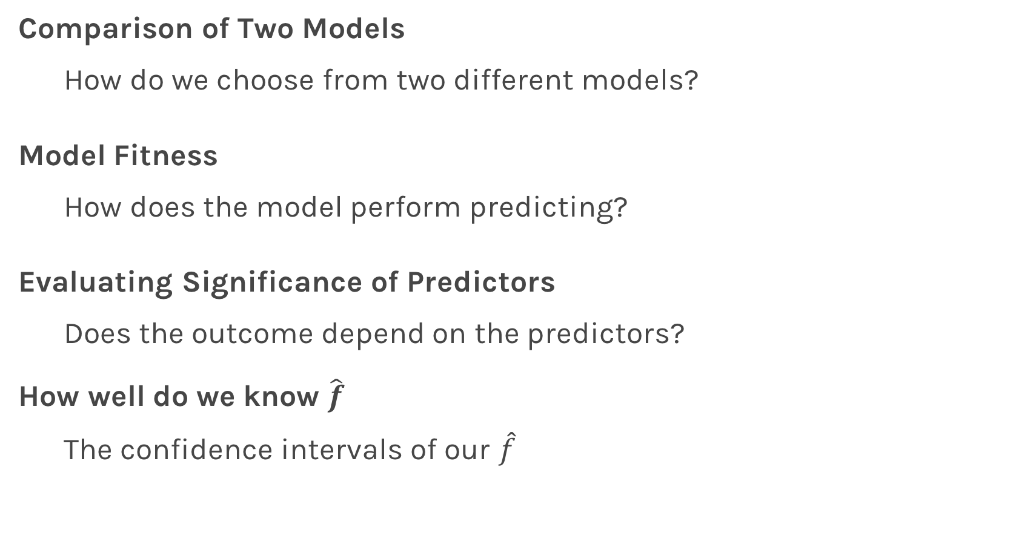
Things to Consider
Comparison of Two Models
How do we choose from two different models?
Model Fitness
How does the model perform predicting?
Evaluating Significance of Predictors
Does the outcome depend on the predictors?
How well do we know $\hat{f}$
The confidence intervals of our $\hat{f}$

Slide 44
Model Comparison

Slide 45
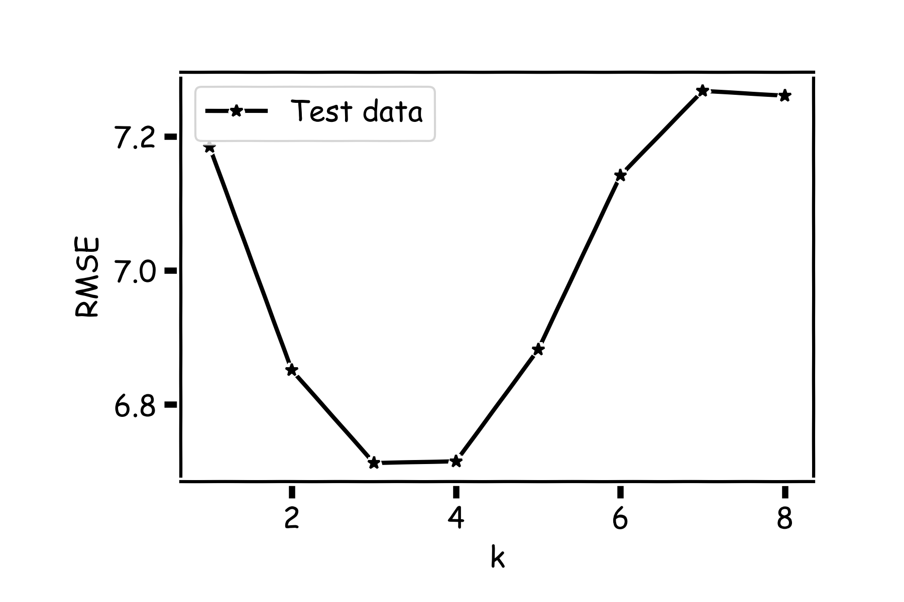
Model Comparison
Do the same for all k’s and compare the RMSEs. k=3 seems to be the best model.

Slide 46
Things to Consider
Comparison of Two Models
How do we choose from two different models?
Model Fitness
How does the model perform predicting?
Evaluating Significance of Predictors
Does the outcome depend on the predictors?
How well do we know $\hat{f}$
The confidence intervals of our $\hat{f}$

Slide 47
Model Fitness

Slide 48
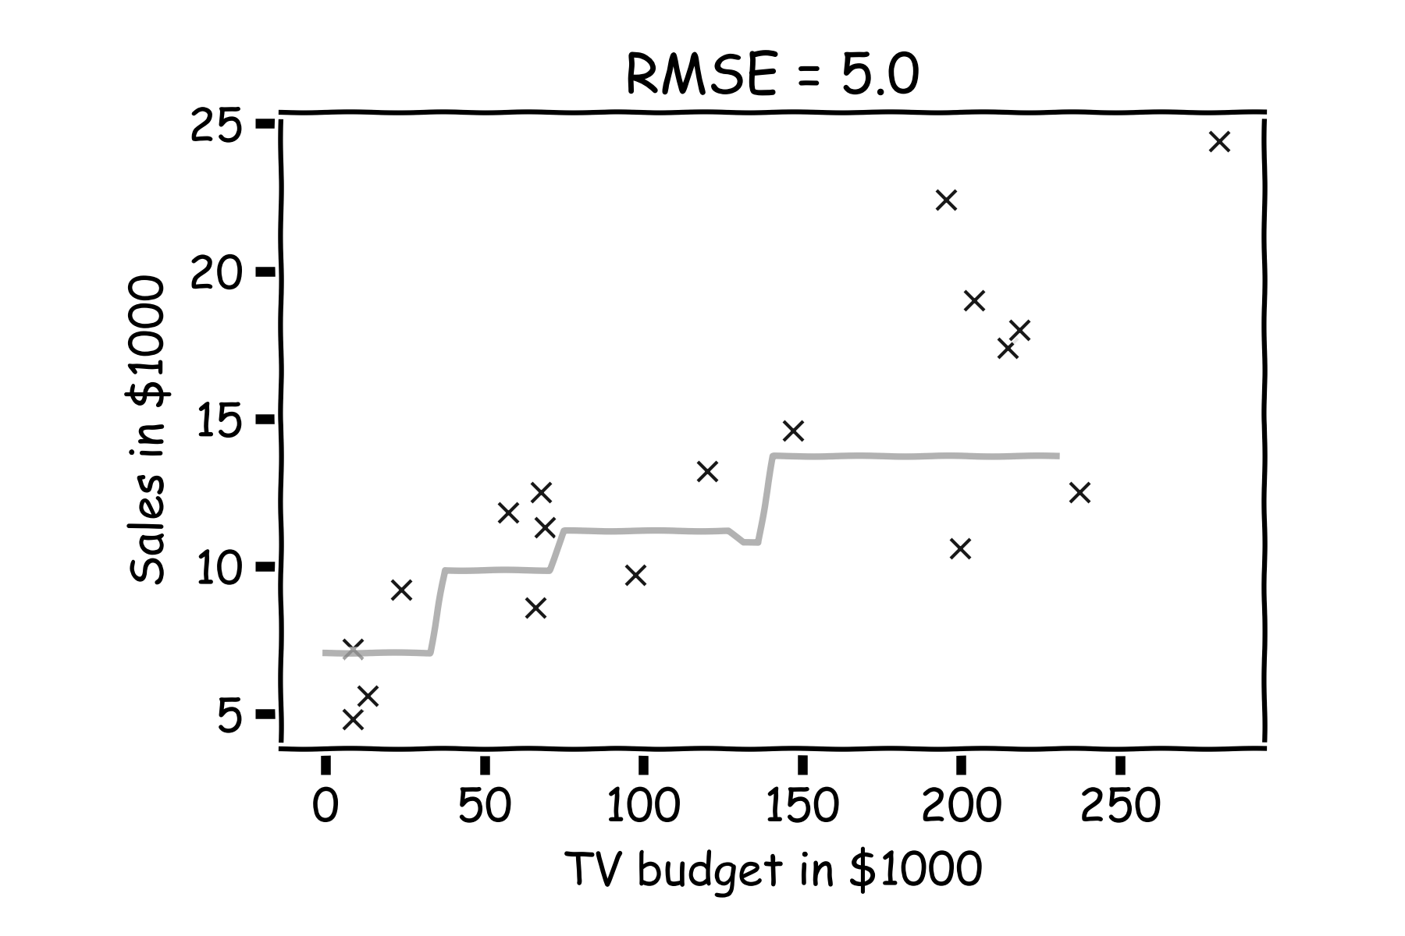
Model fitness
For a subset of the data, calculate the RMSE for k=3. Is RMSE=5.0 good enough?

Slide 49
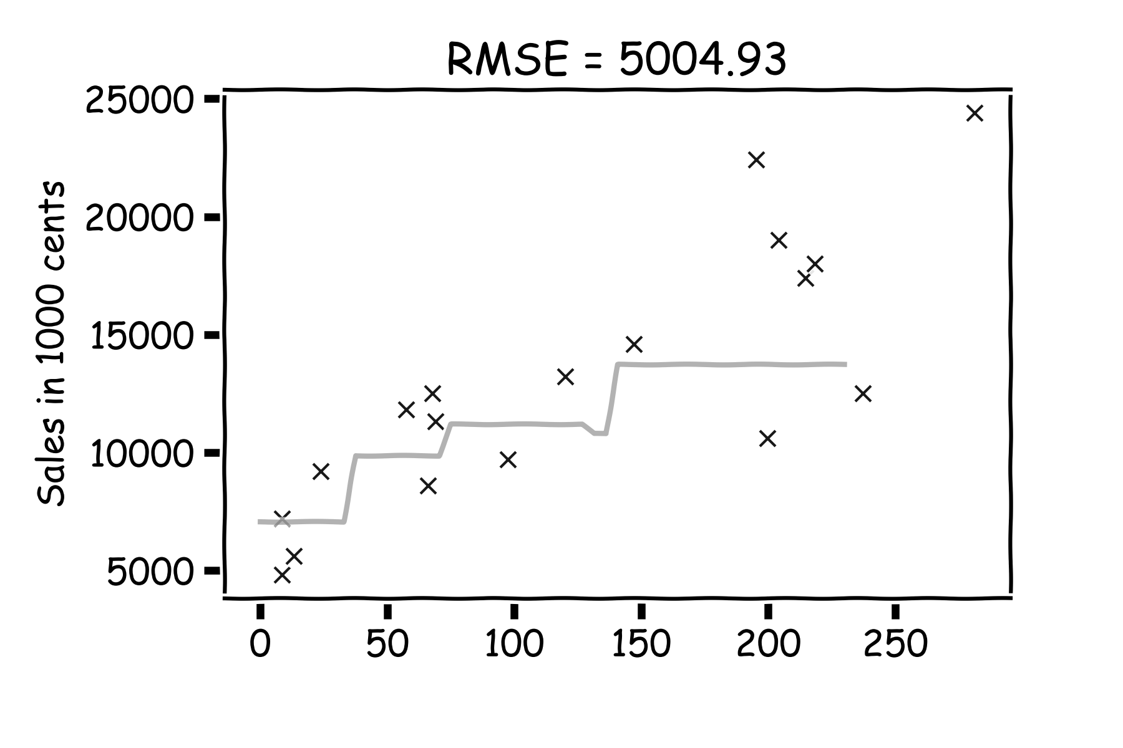
Model fitness
What if we measure the Sales in cents instead of dollars?
RMSE is now 5004.93.
Is that good?

Slide 50
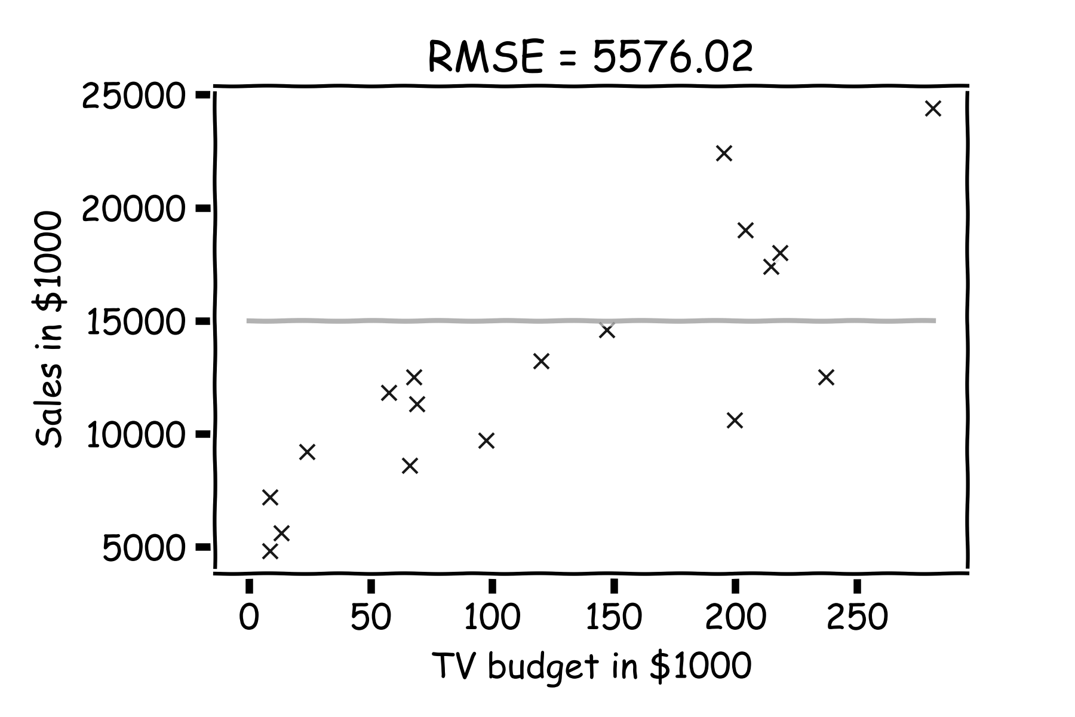
Model fitness
It is better if we compare it to something.
We will use the simplest model:
Notes:
Change this to a nicer plot
The subscript on the summation should be i=1 for clarity. I can’t seem to change this either… (DLS)

Slide 51
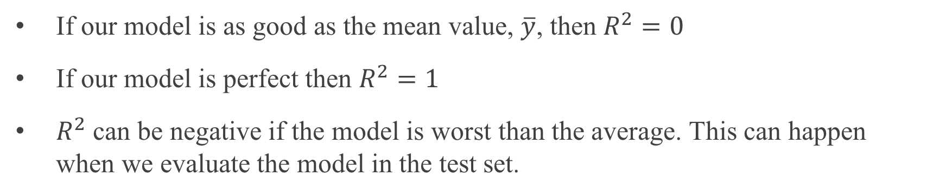
R-squared
If our model is as good as the mean value, $\overline{y}$, then $R^{2}=0$
If our model is perfect then $R^{2}=1$
$R^{2}$ can be negative if the model is worst than the average. This can happen when we evaluate the model in the test set.

Slide 52
Summary
Comparison of Two Models
How do we choose from two different models?
Model Fitness
How does the model perform predicting?
Evaluating Significance of Predictors
Does the outcome depend on the predictors?
How well do we know $\hat{f}$
The confidence intervals of our $\hat{f}$

Slide 53
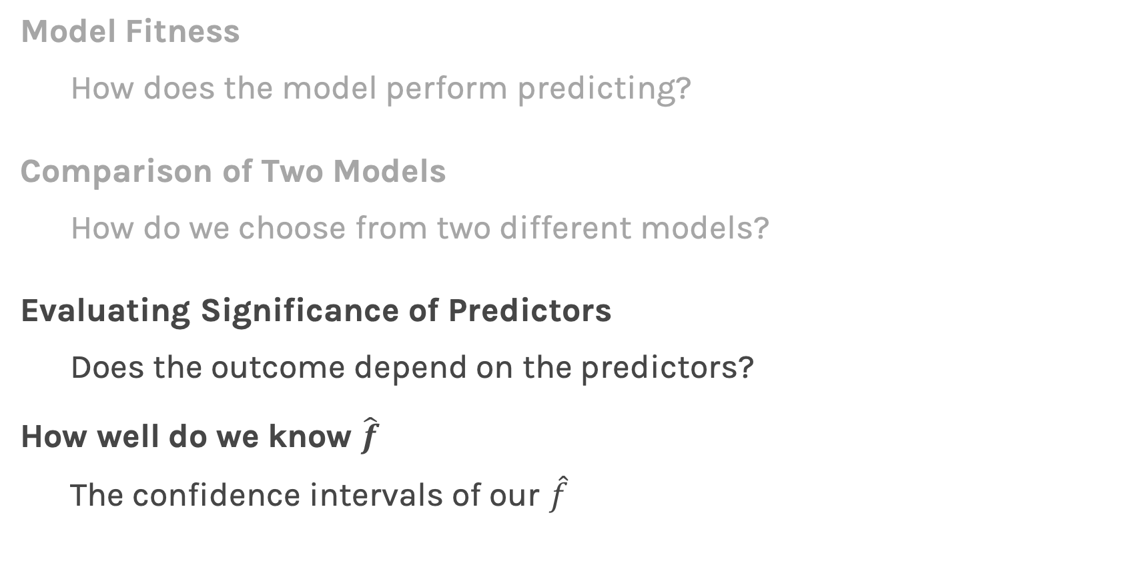
Summary
Model Fitness
How does the model perform predicting?
Comparison of Two Models
How do we choose from two different models?
Evaluating Significance of Predictors
Does the outcome depend on the predictors?
How well do we know $\hat{f}$
The confidence intervals of our $\hat{f}$
Next lecture

Slide 54
Afternoon Exercises
Quiz - to be completed in the next 10 min:
Sway: Lecture 4: Introduction to Regression | part 2
Programmatic – to be completed by next Lecture:
Lessons: Lecture 4: kNN Regression – two (2) exercises

Slide 55


